Slide 1
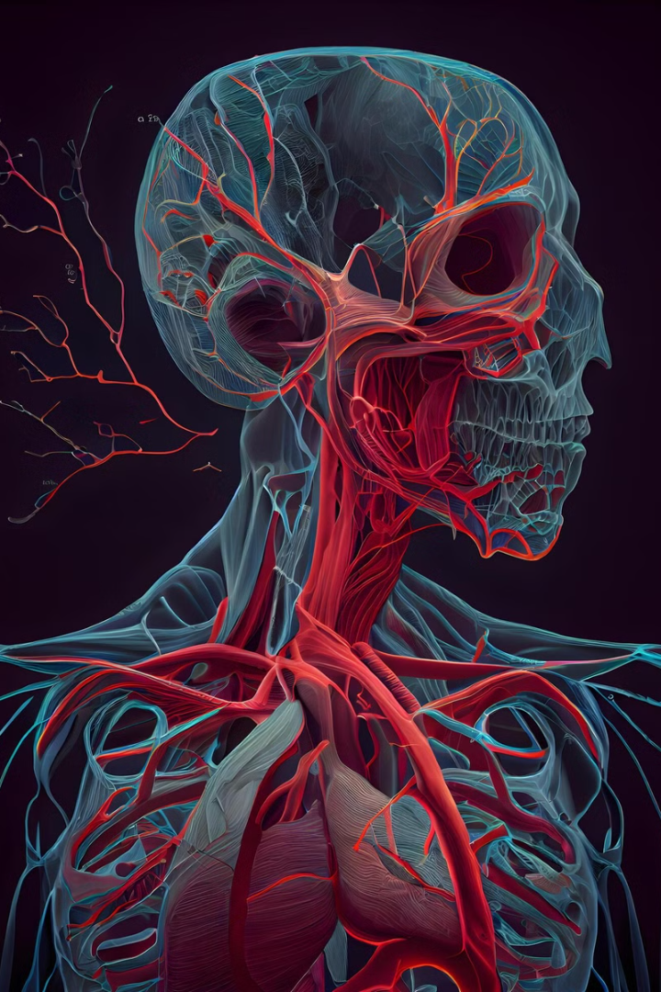
The Cardiovascular System and Organs of Hematopoiesis and Immunogenesis
A comprehensive overview of the circulatory system, blood components, and the organs involved in blood cell production and immune responses. By the end of this lecture, the critical roles these systems play in maintaining overall health and homeostasis will be understood.
Prepared by Abdulhakeem Idris A. and Rahim Israr

Slide 2
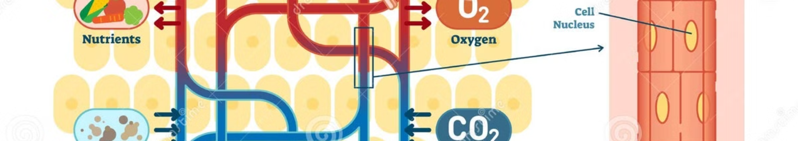
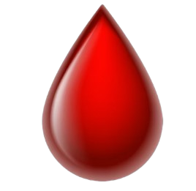
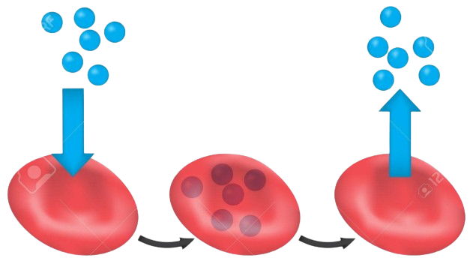

Introduction
The cardiovascular system, also known as the circulatory system, is a complex network of organs and vessels responsible for transporting blood throughout the body. This system ensures the delivery of oxygen, nutrients, hormones, and immune cells to tissues and organs, while simultaneously removing waste products such as carbon dioxide and metabolic byproducts. Its primary functions include maintaining a stable internal environment and defending against pathogens.
Blood Circulation
Oxygen Transport
Waste Removal
The continuous flow of blood ensures oxygen and nutrients are delivered to cells.
Red blood cells carry oxygen from the lungs to tissues throughout the body.
The circulatory system eliminates waste products like carbon dioxide from the body.

Slide 3
Components of the Cardiovascular System
The cardiovascular system consists of three main components: the heart, blood vessels, and blood. Each of these plays a vital role in ensuring efficient circulation and overall system function. The heart acts as the central pump, while blood vessels form a complex network for transporting blood. Blood itself is composed of plasma, red blood cells, white blood cells, and platelets, each with specific functions.
Heart
Blood Vessels
Blood
The heart is a muscular organ that pumps blood throughout the body, ensuring continuous circulation.
Arteries, veins, and capillaries form a complex network that transports blood to and from tissues.
Blood consists of plasma, red blood cells, white blood cells, and platelets, each performing specific functions.

Slide 4
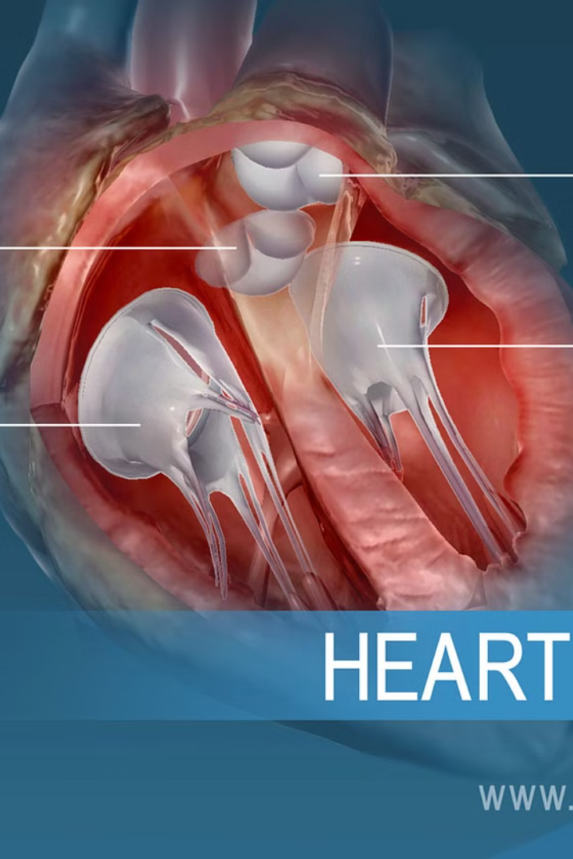
Structure and Function of the Heart
The heart is a four-chambered organ consisting of the left and right atria and the left and right ventricles. The atria receive blood returning to the heart, while the ventricles pump blood out to the lungs and the rest of the body. Valves between the chambers ensure unidirectional blood flow, preventing backflow and maintaining efficient circulation. The heart pumps both oxygenated and deoxygenated blood through separate circuits.
1
Four Chambers
2
Valves
The heart has two atria and two ventricles, each playing a specific role in blood flow.
Valves ensure blood flows in one direction, preventing backflow and maintaining efficiency.
3
Separate Circuits
The heart pumps oxygenated and deoxygenated blood through pulmonary and systemic circuits.

Slide 5
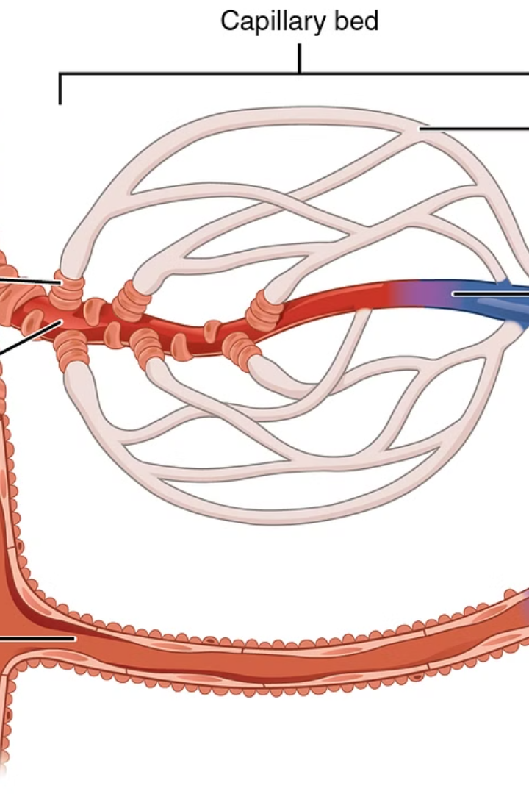
The Network of Blood Vessels
Blood vessels are the pathways through which blood travels, consisting of arteries, veins, and capillaries. Arteries carry oxygenated blood away from the heart to the body's tissues, while veins return deoxygenated blood back to the heart. Capillaries are tiny vessels that facilitate the exchange of gases, nutrients, and waste products at the cellular level, connecting arteries and veins.
Arteries
Carry oxygenated blood away from the heart.
Capillaries
Enable gas and nutrient exchange at the cellular level.
Veins
Return deoxygenated blood to the heart.

Slide 6
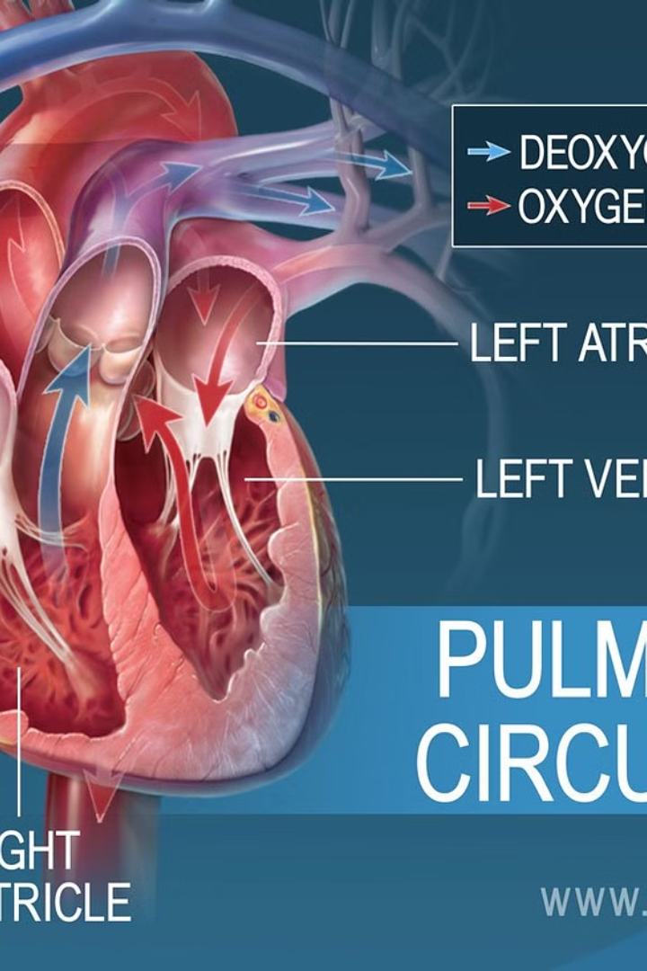
Circulatory Pathways: Systemic, Pulmonary, Coronary
The circulatory system consists of three main pathways: systemic, pulmonary, and coronary circulation. Systemic circulation delivers oxygen-rich blood to the body’s tissues and organs, while pulmonary circulation facilitates the exchange of oxygen and carbon dioxide in the lungs. Coronary circulation supplies blood specifically to the heart muscle, ensuring its proper function.
1
Systemic Circulation
Delivers oxygen-rich blood to tissues and organs throughout the body.
2
Pulmonary Circulation
Exchanges oxygen and carbon dioxide in the lungs.
3
Coronary Circulation
Supplies blood to the heart muscle itself.

Slide 7
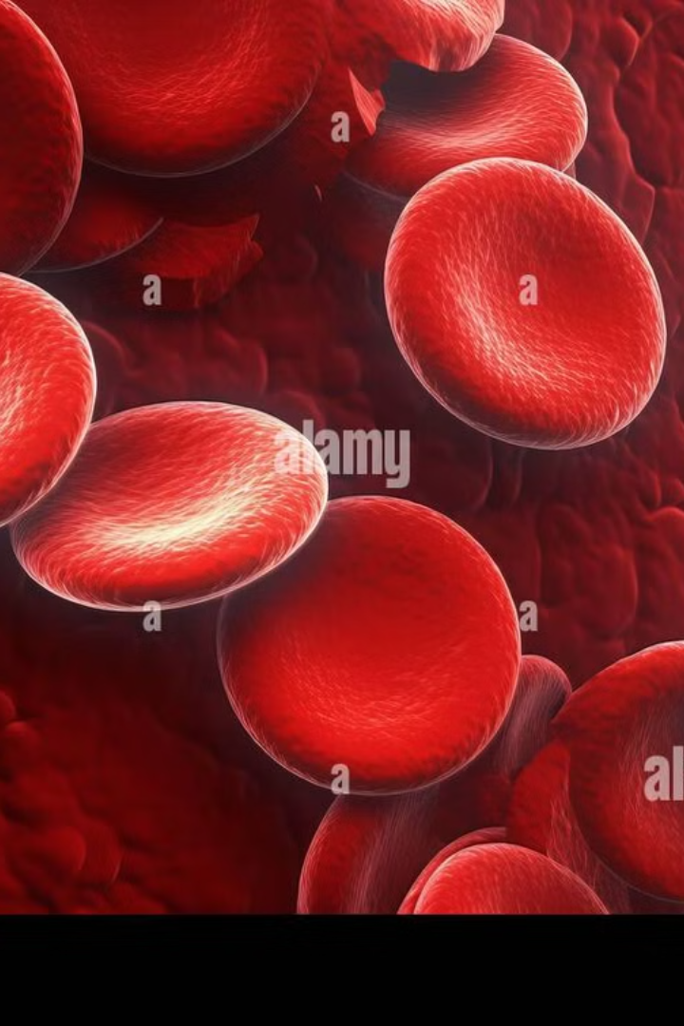
Understanding Blood Composition
Blood is composed of plasma, red blood cells, white blood cells, and platelets, each with distinct functions. Plasma carries nutrients, hormones, and waste products throughout the body. Red blood cells transport oxygen and carbon dioxide. White blood cells are crucial for fighting infections. Platelets assist in blood clotting, preventing excessive bleeding.
Plasma
Carries nutrients, hormones, and waste throughout the body.
Red Blood Cells
Transport oxygen and carbon dioxide between lungs and tissues.
White Blood Cells
Essential for fighting infections and maintaining immunity.
Platelets
Aid in blood clotting, preventing excessive bleeding.

Slide 8
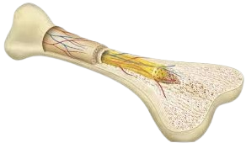
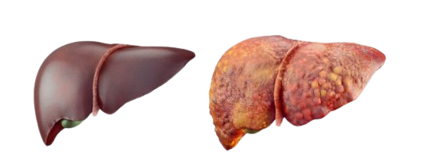
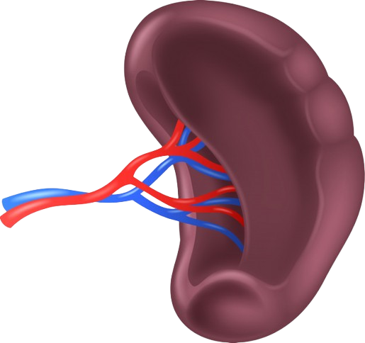
Organs of Hematopoiesis: Blood Cell Production
Hematopoiesis, the production of blood cells, occurs primarily in the bone marrow, liver (during fetal development), and spleen. Bone marrow produces red blood cells, white blood cells, and platelets. The liver supports hematopoiesis during fetal development, and the spleen filters blood and recycles red blood cells, playing a role in both blood cell production and filtration.
1
Bone Marrow
2
Liver
Produces red blood cells, white blood cells, and platelets.
Supports hematopoiesis during fetal development.
3
Spleen
Filters blood and recycles red blood cells.

Slide 9
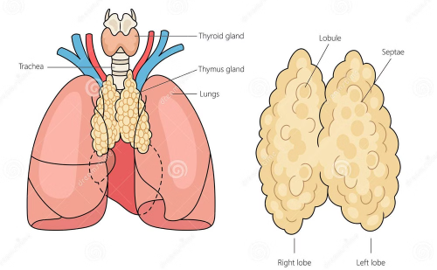
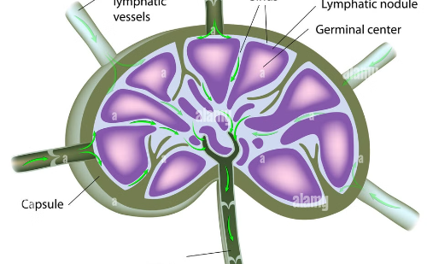
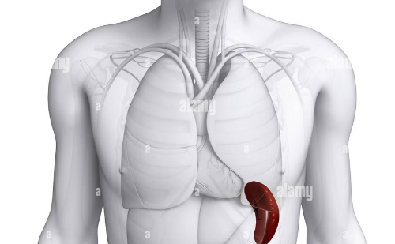
Organs of Immunogenesis: Developing Immunity
Immunogenesis, the development of immunity, involves several key organs, including the thymus, lymph nodes, spleen, tonsils, and Peyer’s patches. The thymus is the site of T-cell maturation, while lymph nodes filter pathogens and activate immune responses. The spleen stores white blood cells and detects infections. Tonsils and Peyer’s patches trap pathogens in the respiratory and digestive systems, providing immune protection.
Thymus
Lymph Nodes
Spleen
Site of T-cell maturation and development.
Filter pathogens and activate immune responses.
Stores white blood cells and detects infections.

Slide 10
The Role of Blood in Immunity
Blood plays a crucial role in immunity by carrying white blood cells to infection sites, facilitating antibody transport, and removing toxins and pathogens. White blood cells, such as lymphocytes and phagocytes, directly attack pathogens and infected cells. Antibodies, produced by B-cells, are transported via blood to neutralize pathogens. The circulatory system also aids in removing toxins and pathogens from the body.
1
Pathogen Removal
Blood helps remove pathogens and toxins from the body
2
Antibody Transport
Facilitates the transport of antibodies to infection sites
3
White Blood Cells
Carries white blood cells to infection sites

Slide 11
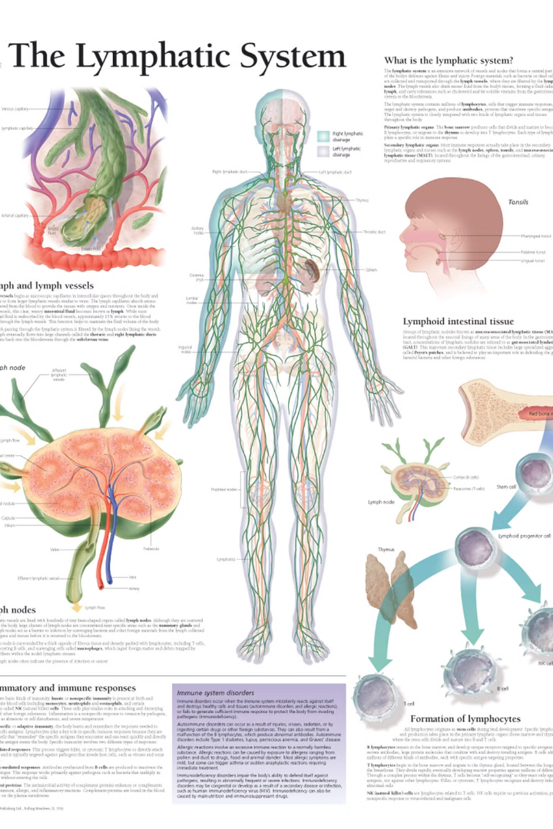
The Lymphatic System
A network of tissues, vessels, and organs that help maintain fluid balance, absorb fats, and support immune function.
Main Components:
Lymph – A clear fluid that transports white blood cells and removes waste.
Lymph Vessels – Tubes that carry lymph throughout the body.
Lymph Nodes – Small, bean-shaped structures that filter harmful substances.
Spleen – Helps filter blood and fight infections.
Thymus – Produces T-cells for immune response.
Tonsils & Adenoids – Help trap pathogens from entering through the mouth and nose.
Functions:
Removes excess fluid from tissues.
Absorbs and transports fats from digestion.
Defends the body against infections and diseases.

Slide 12
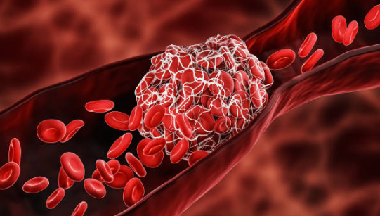

Blood Clotting Mechanism
A biological process that prevents excessive bleeding when a blood vessel is injured.
Key Steps:
Vascular Spasm – Blood vessels constrict to reduce blood flow.
Platelet Plug Formation – Platelets adhere to the site of injury and form a temporary plug.
Coagulation (Clotting Cascade) – A series of reactions activate clotting factors leading to fibrin formation.
Clot Retraction – The clot tightens, reducing the wound size.
Fibrinolysis – The clot is gradually dissolved after healing.
Key Components:
Platelets – Small cell fragments that initiate clotting.
Clotting Factors – Proteins (e.g., fibrinogen, prothrombin) that regulate coagulation.
Fibrin – A protein that forms a mesh to stabilize the clot.

Slide 13
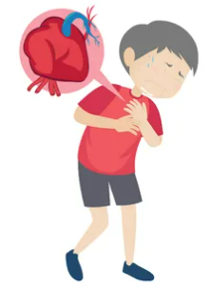
Cardiovascular Diseases
Cardiovascular diseases are a leading health concern worldwide, affecting millions of people. Common conditions include hypertension, which increases blood pressure, and atherosclerosis, where arteries narrow due to plaque buildup. These can lead to severe complications such as heart attacks and strokes. Lifestyle choices, including diet, exercise, and stress management, significantly influence cardiovascular health.
1
Hypertension
High blood pressure damages arteries.
2
Atherosclerosis
Plaque (Fatty) buildup in arteries restricts blood flow, increasing the risk of
disease.

Slide 14
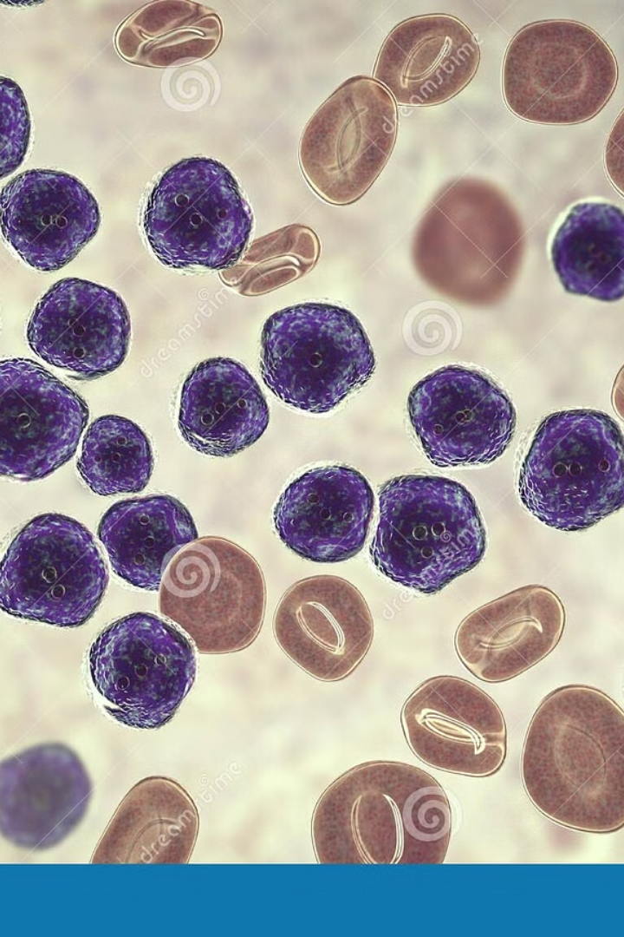
Hematopoietic Disorders
Hematopoietic disorders affect blood cell production and can lead to conditions like anemia, leukemia, and bone marrow failure. These disorders impact red blood cells, white blood cells, or platelets, affecting oxygen transport, immunity, and clotting. Symptoms vary depending on the disorder and may include fatigue, infections, or bleeding. Treatment options depend on the diagnosis and severity.
Anemia
Low red blood cell count causes fatigue.
Leukemia
Cancer of blood-forming tissues affects white blood cells.

Slide 15
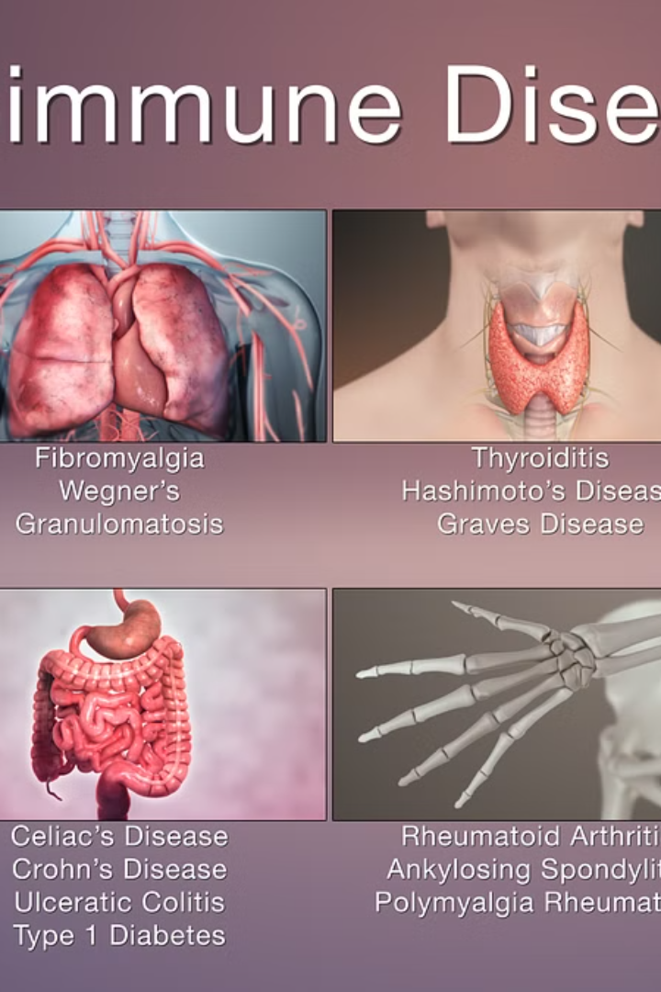
Immune System Disorders
Immune system disorders disrupt normal function, leading to various health problems. Autoimmune diseases cause the immune system to attack healthy tissues, while immunodeficiency weakens the body's ability to fight infections. These disorders can affect blood and cardiovascular health, increasing the risk of inflammation, infections, and organ damage. Treatment depends on the specific condition and severity.
Autoimmunity
Immunodeficiency
Immune system attacks healthy cells.
Reduced ability to fight infections.

Slide 16

Cardiovascular Adaptations in Exercise
Exercise promotes cardiovascular adaptations by strengthening the heart and improving blood flow. Cardiac output increases during physical activity, enhancing oxygen delivery to tissues. Regular exercise helps maintain healthy blood pressure and reduces the risk of heart disease. Over time, these benefits contribute to overall well-being, supporting heart health, endurance, and efficient circulation.
1
Increased Output
Heart pumps more blood per beat.
2
Improved Flow
Blood vessels become more efficient.

Slide 17

Hematopoiesis in Aging
Hematopoiesis changes as people age, leading to shifts in blood cell production. The immune system gradually weakens, making the body more vulnerable to infections and diseases. Blood composition undergoes modifications, affecting overall health. Lifestyle choices, including a balanced diet, regular exercise, and medical check-ups, help maintain immune function and promote well-being in older adults.
Decline
Immune function decreases over time.
Composition
Blood cells shift and change.

Slide 18
Summary and Conclusion
The cardiovascular system is essential for sustaining life by transporting oxygen, nutrients, hormones, and immune cells throughout the body. It maintains circulation, regulates body temperature, and removes metabolic wastes. Hematopoiesis in the bone marrow ensures continuous blood cell production, while immunogenesis generates immune cells, protecting the body from infections, diseases, and harmful pathogens.

Slide 19

THANK YOU

